Slide 1
Fragmentation
Course Code: COE 3206
Course Title: Computer Networks
Dept. of Computer Science
Faculty of Science and Technology
Lecturer No: |  | Week No: |  | Semester:
Lecturer: | Dr. Md Mehedi Hasan; mmhasan@aiub.edu

Slide 2
Lecture Outline
Introduction
Classification
Fragmentation parameters

Slide 3
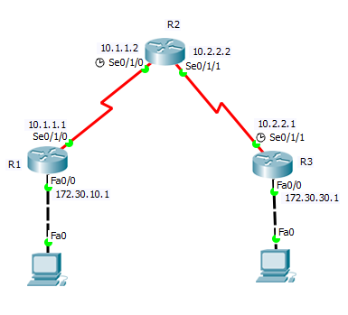
Introduction
Not all networks supports the same packet size.
The reason can be one or more of the following:
1. Hardware (e.g., the size of an Ethernet frame).
2. Operating system (e.g., all buffers are 512 bytes).
3. Protocols (e.g., the number of bits in the packet
length field).
4. Compliance with some (inter)national standard.
5. Desire to reduce error-induced retransmissions to
some level.
6. Desire to prevent one packet from occupying the
channel too long [3].
MTU: 1500 B
MTU: 750 B
Source
Destination
Fig. 9 A sample network

Slide 4
Introduction
What will R2 do when it receives a packet
having length 1500 B?
Fragmentation is a process of breaking a packet into a number of smaller packets, called fragments, to enable the original packet to be sent to destination through a network that supports a lower packet size than the original packet.
MTU: 1500 B
MTU: 750 B
Source
Destination
The fragments are then typically reassembled when they reach their destination.
Fig. 9 A sample network

Slide 5
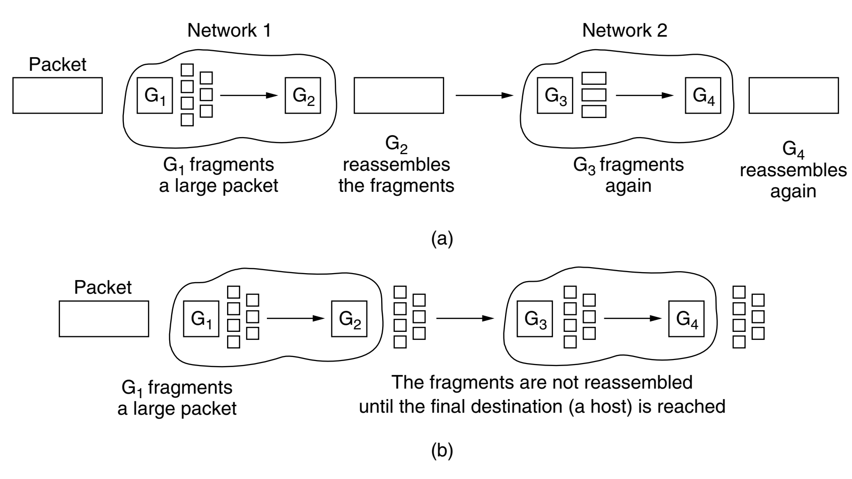
Classification
Transparent fragmentation
Each router reassembles all fragments
and does fragmentation again to fit the data to the next network.
Nontransparent fragmentation
Each router receives all the fragments
and forward the fragments to the next network.
Reassembling is done only in the destination [3].
Fig. 10 (a)Transparent fragmentation
(b) Nontransparent fragmentation
Find merits & demerits of each technique.

Slide 6
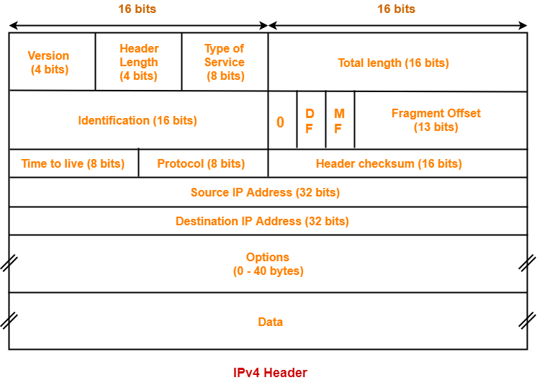
Fragmentation parameters
The fields of the IP header to
accomplish the fragmentation:
Identification
Do not fragments (DF)
More fragment (MF)
Fragment offset [4]
Fig. 11 Packet structure [6]

Slide 7
Fragmentation parameters
Identification:
  All fragments of a packet use a unique identifier.
  Fragments of different packets have different identifier.
  It is a combination of source & destination addresses and Protocol field value of the original packet, allowing the destination to distinguish between the fragments of different packets (from the same source)
Don’t Fragment (DF):
  0 indicates fragmentation is allowed, whereas 1 indicates the prohibition of fragmentation

Slide 8
Fragmentation parameters
More Fragment (MF):
  1 if no fragmentation is done.
  If fragmentation is done, all fragments except the last one has 1 in this field.
Fragmentation offset:
  Indicates the starting position of the data in the fragment in relation to the start of the data in the original packet.
  If a packet containing 800 bytes of data is split into two equal fragments carrying 400 bytes of data, the fragment offset of the first fragment is 0, of the second fragment 50 (400/8).
  The offset value must be the number of 8-byte blocks of data. For example,16 bytes data means two 8 byte blocks. Hence, offset is 2 [4].

Slide 9
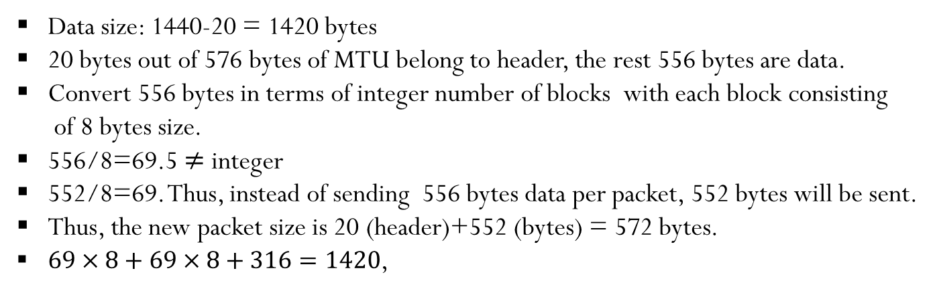
Example
Suppose that a router receives a packet of size 1440 bytes including 20 bytes header.
Packet has to be forwarded through a network which supports MTU of 576 bytes.
Data size: 1440-20 = 1420 bytes
20 bytes out of 576 bytes of MTU belong to header, the rest 556 bytes are data.
Convert 556 bytes in terms of integer number of blocks with each block consisting
of 8 bytes size.
556/8=69.5 $≠$ integer
552/8=69. Thus, instead of sending 556 bytes data per packet, 552 bytes will be sent.
Thus, the new packet size is 20 (header)+552 (bytes) = 572 bytes.
$69×8+69×8+316=1420$,

Slide 10
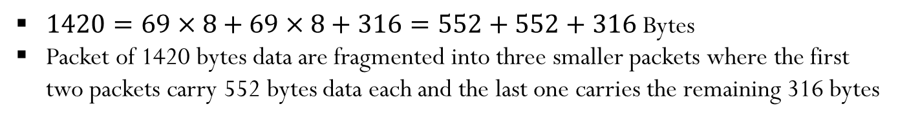
Example
$1420=69×8+69×8+316=552+552+316$ Bytes
Packet of 1420 bytes data are fragmented into three smaller packets where the first
two packets carry 552 bytes data each and the last one carries the remaining 316 bytes
Table I Information about different fragments
Fragment no. | Identification | DF | MF | Fragment offset | Packet size
1 | 9712 (let) | 0 | 1 | 0 | 572 (20+552)
2 | 9712 | 0 | 1 | 69 | 572 (20+552)
3 | 9712 | 0 | 0 | 138 (69*2) | 336 (20+316)

Slide 11
Class Test
Suppose that a router receives a packet of size 1200 bytes including 60 bytes header. Packet has to be forwarded through a network which supports MTU of 656 bytes.
Suppose that a router receives a packet of size 1500 bytes including 40 bytes header. Packet has to be forwarded through a network which supports MTU of 700 bytes.
Suppose that a router receives a packet of size 1120 bytes including 20 bytes header. Packet has to be forwarded through a network which supports MTU of 760 bytes.

Slide 12
Reassembling
Fragments grouping
All fragments having same values for the following fields belong to the same original packet:
identification, source, destination, and protocol.
Original data recovery
Data portion of different fragments are reordered to get the original data order based on the fragment offset in that fragment’s IP header [5].

Slide 13
References
[1] D. Liu, Cisco CCNA/CCENT Exam 640-802, 640-822, 640-816 Preparation
Kit, Syngress Publishing, Inc., 2009, pp. 607-609.
[2] W. Odom, Official Cert Guide CCNA 200-301 Volume 1, Pearson Education,
Inc., USA, 2019, pp. 63-65.
[3] A. S. Tanenbaum and D. J. Wetherall, Computer Networks, 5th ed., Pearson
Education, Inc., USA, 2010, pp. 432-436.
[4] Packet Pusher, https://packetpushers.net/ip-fragmentation-in-detail,
[Accessed: April. 29, 2020].
[5] RFC, https://tools.ietf.org/html/rfc791, [Accessed: April. 29, 2020].
[6] Gatevidyalay, https://www.gatevidyalay.com/ipv4-ipv4-header-ipv4-header-
format/, [Accessed: April. 29, 2020].

Slide 14
Recommended Books
  Data Communications and Networking, B. A. Forouzan, McGraw-Hill, Inc., Fourth Edition, 2007, USA.
  Computer Networking: A Top-Down Approach, J. F., Kurose, K. W. Ross, Pearson Education, Inc., Sixth Edition, USA.
  Official Cert Guide CCNA 200-301 , vol. 1, W. Odom, Cisco Press, First Edition, 2019, USA.
  CCNA Routing and Switching, T. Lammle, John Wily & Sons, Second Edition, 2016, USA.
  TCP/IP Protocol Suite, B. A. Forouzan, McGraw-Hill, Inc., Fourth Edition, 2009, USA.
  Data and Computer Communication, W. Stallings, Pearson Education, Inc., Tenth Education, 2013, USA.

